Slide 1
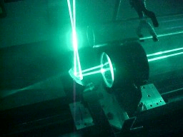
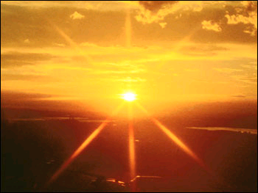
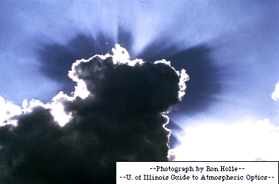
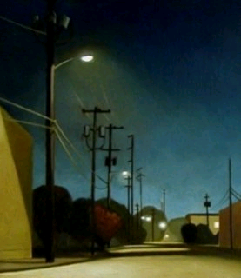
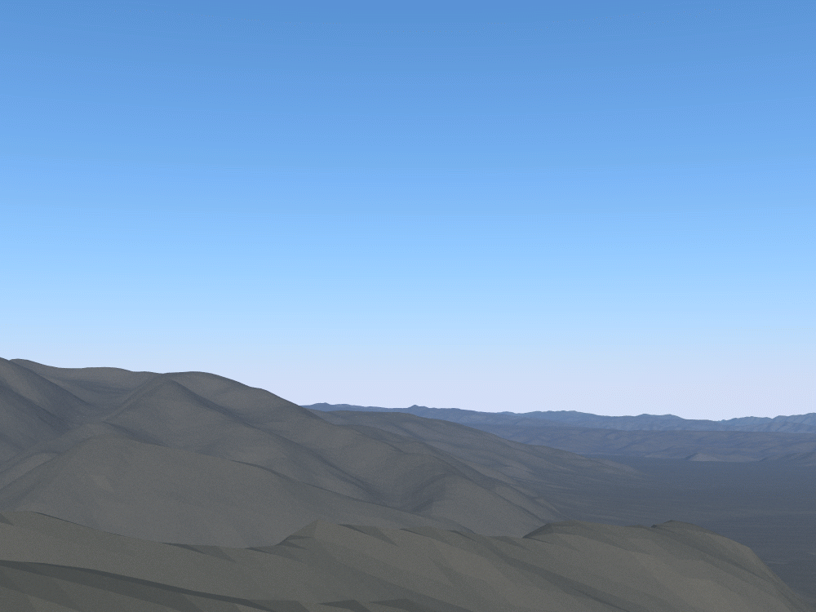
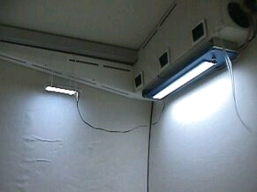
Computer Graphics III – Radiometry
Jaroslav Křivánek, MFF UK
Jaroslav.Krivanek@mff.cuni.cz

Slide 2
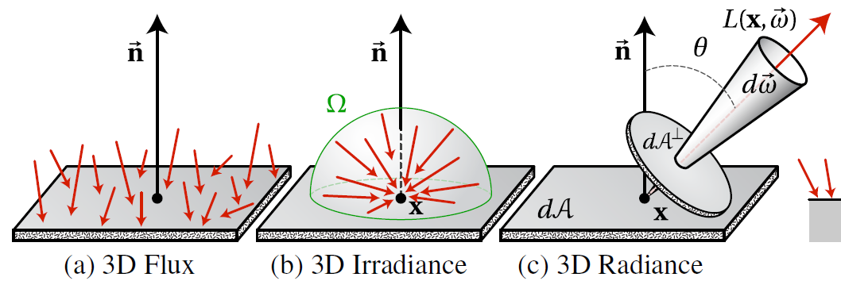
Basic radiometric quantities
Image: Wojciech Jarosz

Slide 3
Direction, solid angle, spherical integrals

Slide 4
Direction in 3D
Direction = unit vector in 3D
Cartesian coordinates
Spherical coordinates
θ … polar angle – angle from the Z axis
φ ... azimuth – angle measured counter-clockwise from the X axis

Slide 5
Function on a unit sphere
Function as any other, except that its argument is a direction in 3D
Notation
F(ω)
F(x,y,z)
F(θ,φ)
…
Depends in the chosen representation of directions in 3D

Slide 6
Solid angle
Planar angle
Arc length on a unit circle
A full circle has 2π radians (unit circle has the length of 2π)
Solid angle (steradian, sr)
Surface area on an unit sphere
Full sphere has 4π steradians

Slide 7
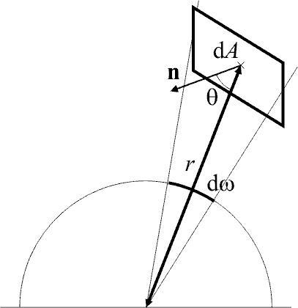
Differential solid angle
“Infinitesimally small” solid angle around a given direction
By convention, represented as a 3D vector
Magnitude … dω
Size of a differential area on the unit sphere
Direction … ω
Center of the projection of the differential area on the unit sphere

Slide 8
Differential solid angle
(Differential) solid angle subtended by a differential area

Slide 9
Differential solid angle
dθ
r
θ
φ
dφ

Slide 10
Radiometry and photometry

Slide 11
Radiometry and photometry
“Radiometry is a set of techniques for measuring electromagnetic radiation, including visible light.
Radiometric techniques in optics characterize the distribution of the radiation's power in space, as opposed to photometric techniques, which characterize the light's interaction with the human eye.” (Wikipedia)

Slide 12
Radiometry and photometry
Radiometric quantities
Radiant energy (zářivá energie) – Joule
Radiant flux (zářivý tok) – Watt
Radiant intensity (zářivost) – Watt/sr
Denoted by subscript e
Photometric quantities
Luminous energy (světelná energie) – Lumen-second, a.k.a. Talbot
Luminous flux (světelný tok) – Lumen
Luminous intensity (svítivost) – candela
Denoted by subscript v

Slide 13
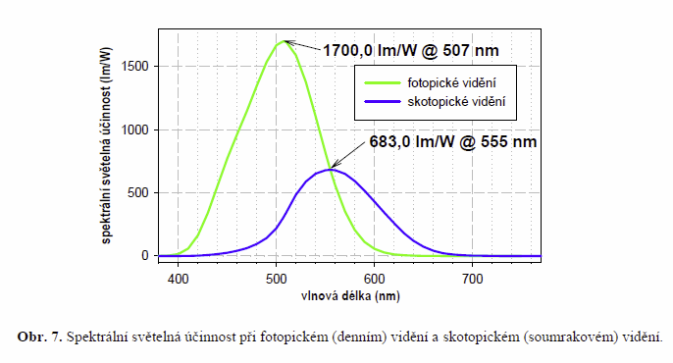
Relation between photo- and radiometric quantities
Spectral luminous efficiency K(λ)
skotopické vidění
Source: M. Procházka: Optika pro počítačovou grafiku
fotopické vidění

Slide 14
Relation between photo- and radiometric quantities
Visual response to a spectrum:

Slide 15
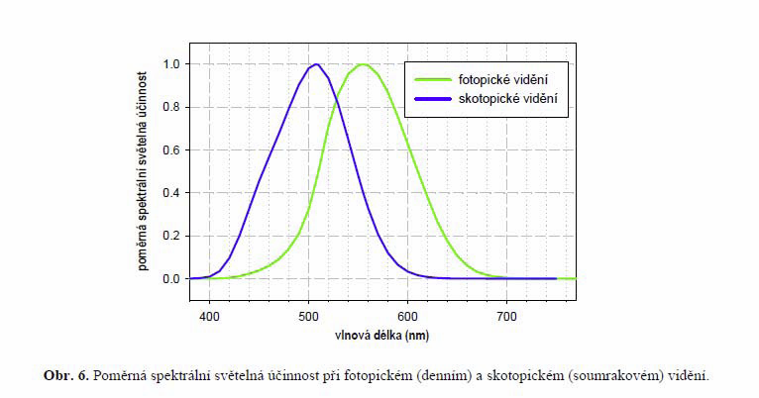
Relation between photo- and radiometric quantities
Relative spectral luminous efficiency V(λ)
Sensitivity of the eye to light of wavelength λ relative to the peak sensitivity at λ_{max} = 555 nm (for photopic vision).
CIE standard 1924
Source: M. Procházka: Optika pro počítačovou grafiku

Slide 16
Relation between photo- and radiometric quantities
Radiometry
More fundamental – photometric quantities can all be derived from the radiometric ones
Photometry
Longer history – studied through psychophysical (empirical) studies long before Maxwell equations came into being.

Slide 17
Radiometric quantities

Slide 18
Transport theory
Empirical theory describing flow of “energy” in space
Assumption:
Energy is continuous, infinitesimally divisible
Needs to be taken so we can use derivatives to define quantities
Intuition of the “energy flow”
Particles flying through space
No mutual interactions (implies linear superposition)
Energy density proportional to the density of particles
This intuition is abstract, empirical, and has nothing to do with photons and quantum theory

Slide 19
Radiant energy – Q [J]
Time interval
Unit: Joule, J
Wavelength interval
Q (S, <t₁, t₂>, <λ₁, λ₂>)
Surface in 3D
(imaginary or real)
S

Slide 20
Spectral radiant energy – Q [J]
Energy of light at a specific wavelength
„Density of energy w.r.t wavelength“
We will leave out the subscript and argument λ for brevity
We always consider spectral quantities in image synthesis
Photometric quantity:
Luminous energy, unit Lumen-second aka Talbot

Slide 21
Radiant flux (power) – Φ [W]
How quickly does energy „flow“ from/to surface S?
„Energy density w.r.t. time“
Unit: Watt – W
Photometric quantity:
Luminous flux, unit Lumen

Slide 22
Irradiance– E [W.m⁻²]
What is the spatial flux density at a given point x on a surface S?
Always defined w.r.t some point x on S with a specified surface normal N(x).
Irradiance DOES depend on N(x) (Lambert law)
We’re only interested in light arriving from the “outside” of the surface (given by the orientation of the normal).

Slide 23
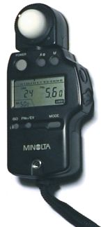
Irradiance – E [W.m⁻²]
Unit: Watt per meter squared – W.m⁻²
Photometric quantity:
Illuminance, unit Lux = lumen.m⁻²
light meter
(cz: expozimetr)

Slide 24
Lambert cosine law
Johan Heindrich Lambert, Photometria, 1760
A
Φ

Slide 25
Lambert cosine law
Johan Heindrich Lambert, Photometria, 1760
A
A’=A / cosθ
Φ
θ

Slide 28
Radiant exitance – B [W.m⁻²]
Same as irradiance, except that it describes exitant radiation.
The exitant radiation can either be directly emitted (if the surface is a light source) or reflected.
Common name: radiosity
Denoted: B, M
Unit: Watt per meter squared – W.m⁻²
Photometric quantity:
Luminosity, unit Lux = lumen.m⁻²

Slide 29
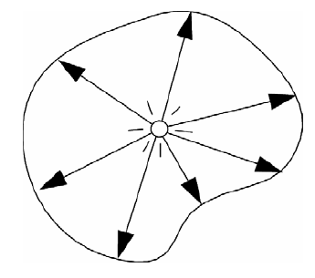
Radiant intensity – I [W.sr⁻¹]
Angular flux density in direction ω
Definition: Radiant intensity is the power per unit solid angle emitted by a point source.
Unit: Watt per steradian – W.sr⁻¹
Photometric quantity
Luminous intensity, unit Candela (cd = lumen.sr⁻¹), SI base unit

Slide 30
Point light sources
Light emitted from a single point
Mathematical idealization, does not exist in nature
Emission completely described by the radiant intensity as a function of the direction of emission: I(ω)
Isotropic point source
Radiant intensity independent of direction
Spot light
Constant radiant intensity inside a cone, zero elsewhere
General point source
Can be described by a goniometric diagram
Tabulated expression for I(ω) as a function of the direction ω
Extensively used in illumination engineering

Slide 31
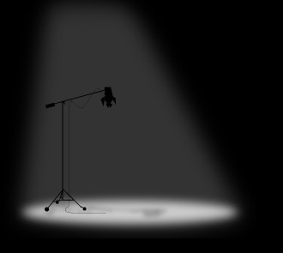
Spot Light
Point source with a directionally-dependent radiant intensity
Intensity is a function of the deviation from a reference direction d :
E.g.
What is the total flux emitted by the source in the cases (1) a (2)? (See exercises.)
(1)
(2)
d
ω

Slide 33
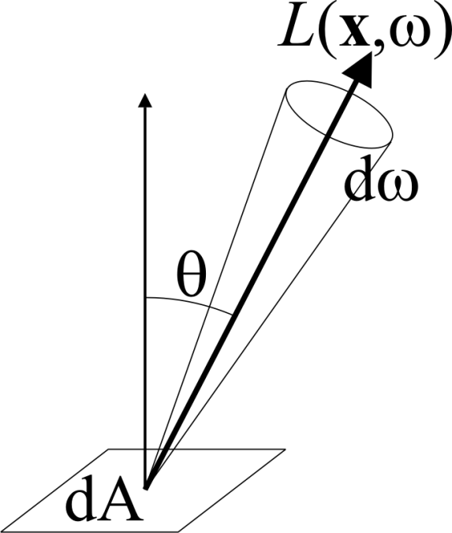
Radiance – L [W.m⁻².sr⁻¹]
Spatial and directional flux density at a given location x and direction ω.
Definition: Radiance is the power per unit area perpendicular to the ray and per unit solid angle in the direction of the ray.

Slide 34
Radiance – L [W.m⁻².sr⁻¹]
Spatial and directional flux density at a given location x and direction ω.
Unit: W. m⁻².sr⁻¹
Photometric quantity
Luminance, unit candela.m⁻² (a.k.a. Nit – used only in English)

Slide 35
The cosine factor cos θ in the definition of radiance
cos θ compensates for the decrease of irradiance with increasing θ
The idea is that we do not want radiance to depend on the mutual orientation of the ray and the reference surface
If you illuminate some surface while rotating it, then:
Irradiance does change with the rotation (because the actual spatial flux density changes).
Radiance does not change (because the flux density change is exactly compensated by the cos θ factor in the definition of radiance). And that’s what we want.

Slide 40
Calculation of the remaining quantities from radiance
= projected solid angle
= hemisphere above the point x

Slide 41
Area light sources
Emission of an area light source is fully described by the emitted radiance L_{e}(x,ω) for all positions on the source x and all directions ω.
The total emitted power (flux) is given by an integral of L_{e}(x,ω) over the surface of the light source and all directions.

Slide 42
Properties of radiance (1)
Radiance is constant along a ray in vacuum
Fundamental property for light transport simulation
This is why radiance is the quantity associated with rays in a ray tracer
Derived from energy conservation (next two slides)

Slide 43
Energy conservation along a ray
L₁(ω)
r
emitted flux
received flux
dω₁
dA₁
L₂(ω)
dω₂
dA₂

Slide 44
Energy conservation along a ray
L₁(ω)
r
dω₁
dA₁
L₂(ω)
ray throughput
dω₂
dA₂

Slide 45
Properties of radiance (2)
Sensor response (i.e. camera or human eye) is directly proportional to the value of radiance reflected by the surface visible to the sensor.
Sensor area A₂
Aperture area A₁

Slide 46
Incoming / outgoing radiance
Radiance is discontinuous at an interface between materials
Incoming radiance – L^{i}(x,ω)
radiance just before the interaction (reflection/transmission)
Outgoing radiance – Lº(x,ω)
radiance just after the interaction

Slide 47
Radiometric and photometric terminology
Fyzika Physics | Radiometrie Radiometry | Fotometrie Photometry
Energie Energy | Zářivá energie Radiant energy | Světelná energie Luminous energy
Výkon (tok) Power (flux) | Zářivý tok Radiant flux (power) | Světelný tok (výkon) Luminous power
Hustota toku Flux density | Ozáření Irradiance | Osvětlení Illuminance
dtto | Intenzita vyzařování Radiosity | ??? Luminosity
Úhlová hustota toku Angular flux density | Zář Radiance | Jas Luminance
??? Intensity | Zářivost Radiant Intensity | Svítivost Luminous intensity

Slide 48
Next lecture
Light reflection on surfaces

